Slide 1
APOLOGETICS
IN ONE LESSON
almost
Ai1L.net
Lesson 24
Jesus Died by Crucifixion; His Disciples Believed He Resurrected

Slide 2
Read the non-Christian accounts of Jesus’ death by crucifixion
1

Slide 3
“...one is obliged to say, 'Here was a man. This part of the tale could not have been invented.'”
H.G. WELLS The Outline of History, Volume 1, page 497

Slide 4
Read the Gospels accounts of Jesus’ death by crucifixion
2

Slide 5
Document the claims of the early witnesses of Jesus’ resurrection
3

Slide 6
“This is the sort of truth that is hard to explain because it is a fact; but it is a fact to which we can call witnesses”
G.K. Chesterton The Everlasting Man

Slide 7
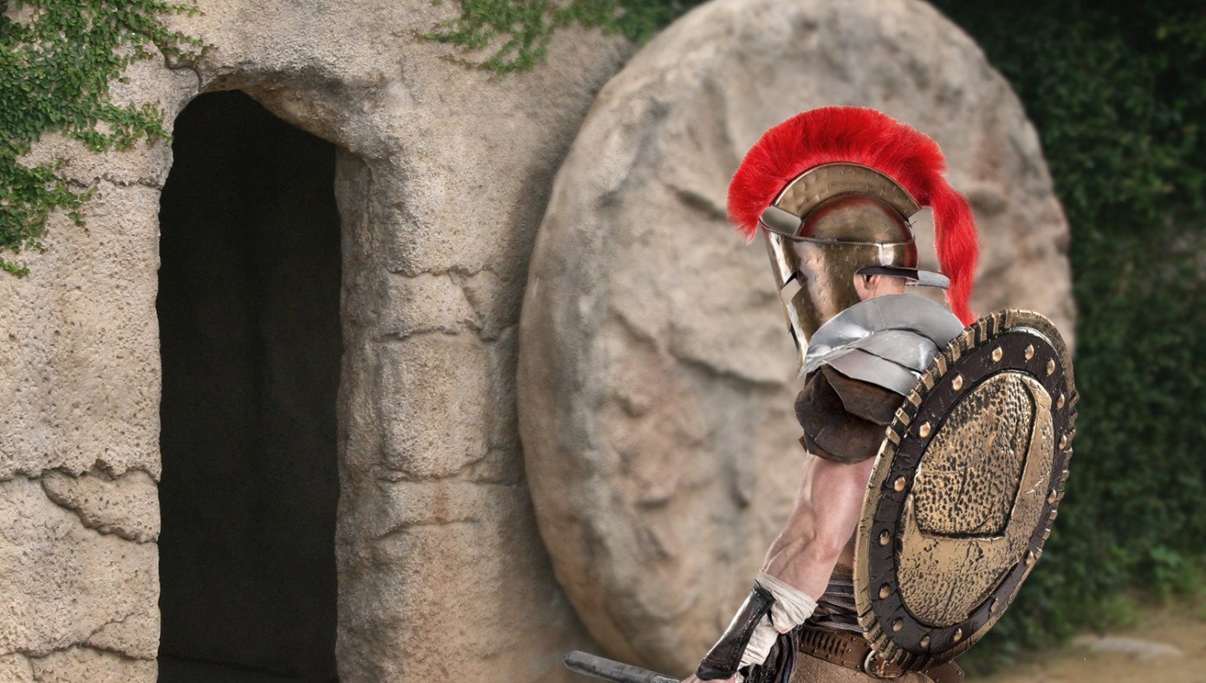
Roman Authorities Investigating Jesus For Violating Stay-In-Tomb Order
BABYLON BEE April 12th, 2020 http://bit.ly/Ai1LStayInTomb

